Slide 1
OPTOKON group in the world of current security challenges
Ing. Tomas Müller
director of ICT division
OPTOKON, a.s.,

Slide 2
OPTOKON GROUP KEY DATES
1991 - Established in the Czech Republic taking over the extended production program of optical connectors produced by TESLA Jihlava
1996 - Subsidiary of USA company METHODE ELECTRONICS, Inc. & ISO 9002 approved company
1999 - Independent ISO 9000 OPTOKON Calibration Laboratory established
2001 - Main member of Fiber Optic normalization council CENELEC
2002 - “NBU” (NATO) approved company from the spring of 2002
2006 - Established OptoNet Communication - Data network services and Optical line
2007 - Expanding of OPTOKON Group to main European countries
2011 - OPTOKON as purely Czech company & Expanding to Middle East
2013 - Licence for transfer xPON technologies to OPTOKON
2015 - Expanding to Aisa-Pacific - Established OPTOKON Malaysia
2015 - Established OPTOKON Kable – Expanding to fiber optic cable manufacturing
2015 - AQAP 2110 approved company
2016 - Set up of OPTOKON Calibration Laboratories in Kualu Lumpur & Ipoh ; Malaysia
2018 - OPTOKON Testing division according to the standard ČSN EN ISO/IEC 17025
2019 - Opening OPTOKON Turkey office
2021 - Opening OPTOKON Elektronik Limited Şirketi, Turkey
2021 – New OptoNet Datové Centrum Vysočina – Expanding data network services, Meet Tier 4 Certification

Slide 4
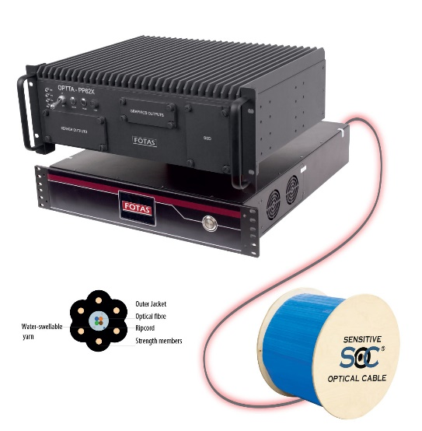
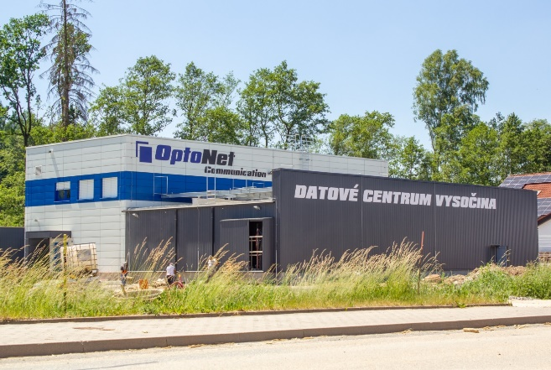
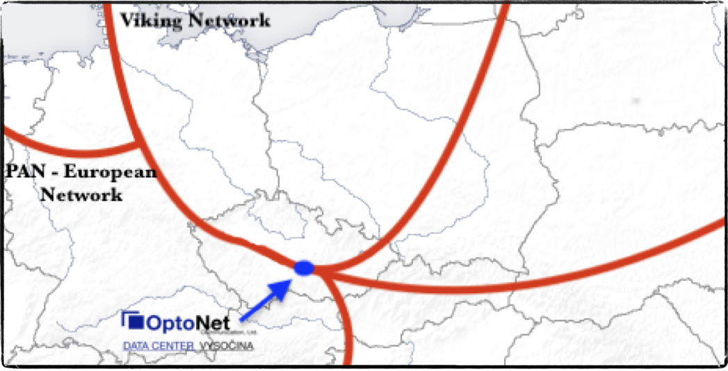
The key OPTOKON security challenges…
DC Vysočina – data center with specialization on
…provisioning of security technologies and complex solutions as a service
…demonstration environment of new technologies and services
…regional education and expert meeting center

Slide 5
…live demonstration and more information in the foyer…
OPTOKON, a.s.
Červený Kříž 250
586 01 Jihlava, Czech Republic
tel. +420 564 040 111
fax +420 564 040 134
OPTOKON@OPTOKON.COM
WWW.OPTOKON.COM

